Slide 1
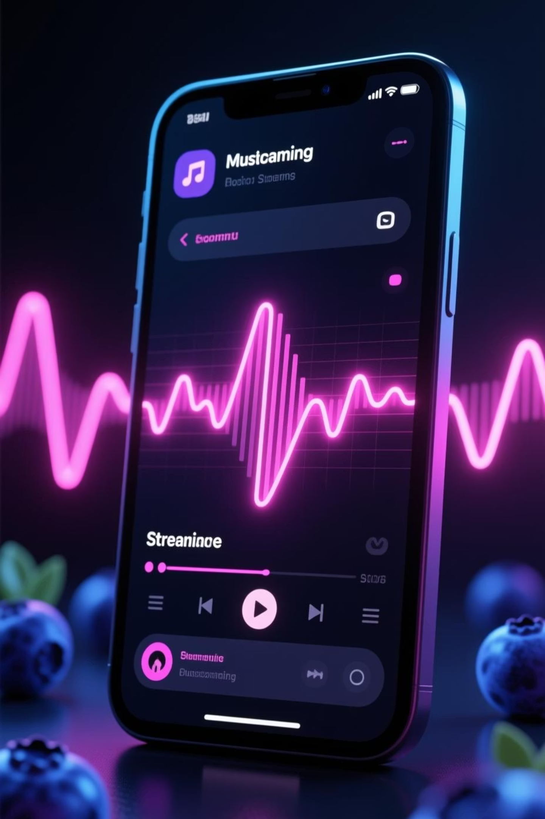
EchoTune
Discover the next generation of music streaming for modern creators

Slide 2

The EchoTune Vision
EchoTune reimagines music streaming through the lens of creator empowerment and listener connection. In a crowded market dominated by algorithmic feeds and generic playlists, EchoTune puts human curation at the center, enabling artists to tell their stories directly while giving listeners meaningful discovery experiences.
Our platform bridges the gap between emerging artists and engaged audiences, creating a community where music feels personal again.

Slide 3



The Core Problem
Creator Frustration
Listener Fatigue
Independent artists struggle with algorithmic invisibility. Playlist placement is opaque, compensation is unclear, and direct listener relationships are impossible to build.
Endless algorithmic recommendations feel impersonal. Discovery feels random, and users crave authentic stories behind the music they love.
Platform Limitation
Existing streaming platforms prioritize major labels and ad revenue over artist sustainability and meaningful user experiences.

Slide 4
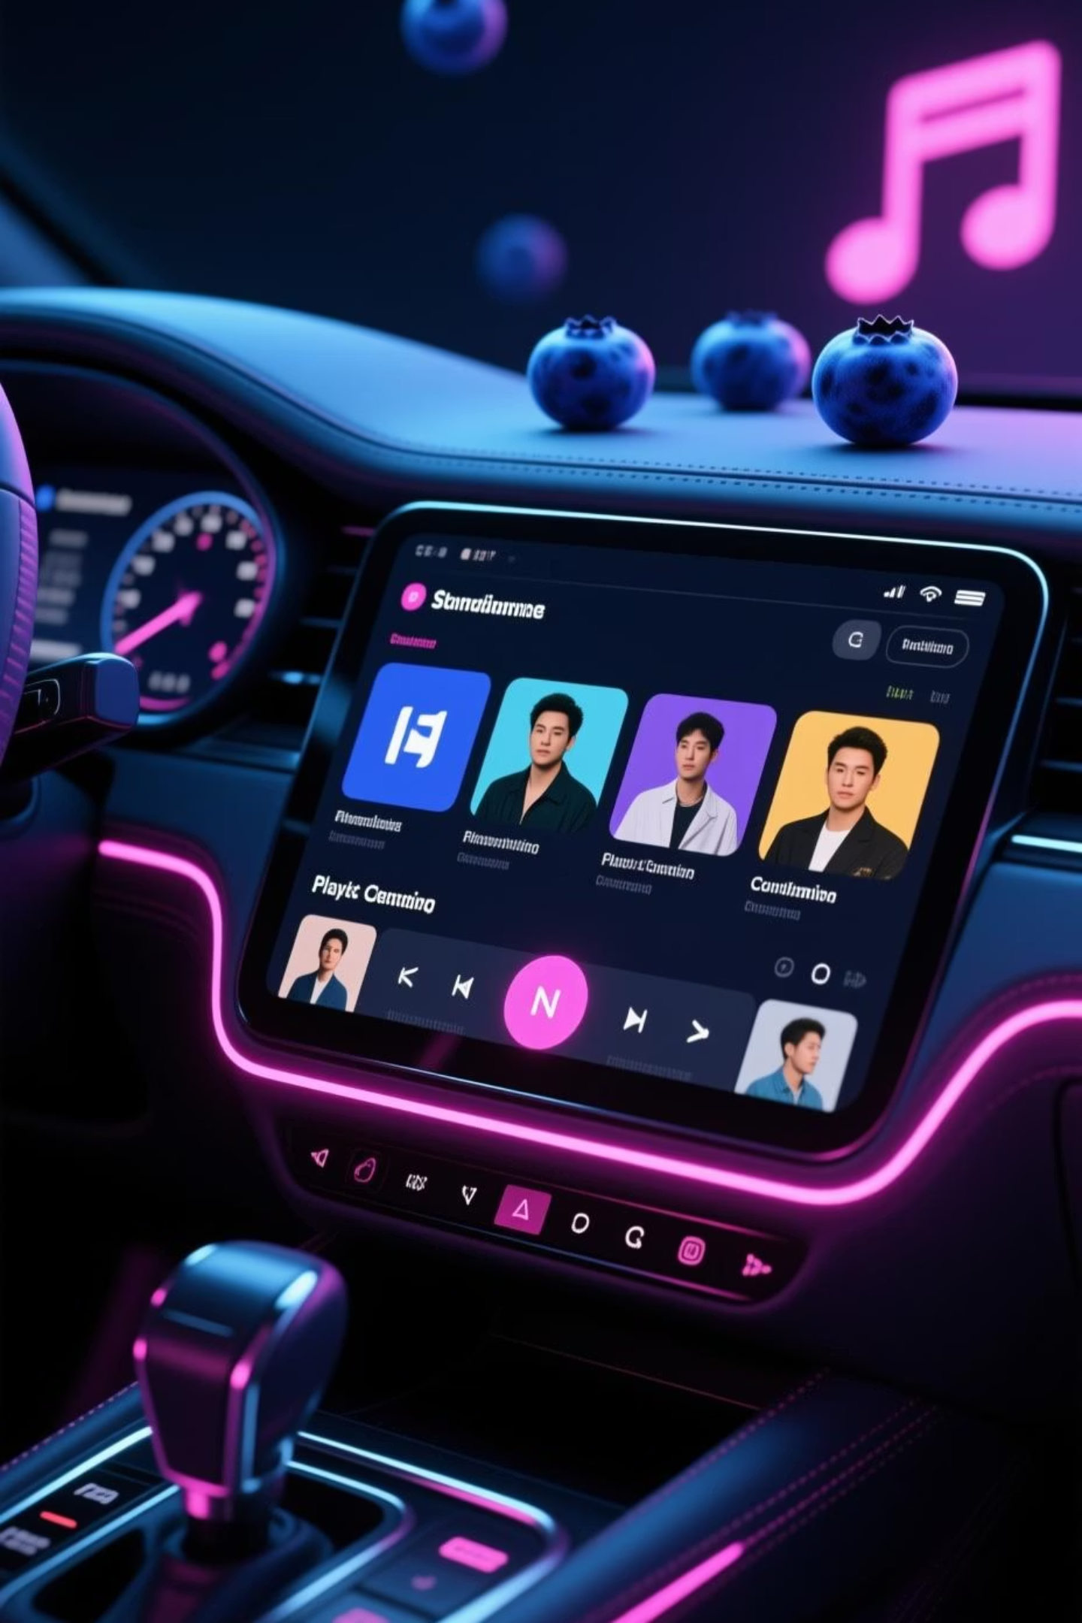




EchoTune's Unique Features
Artist Spotlight
Human Curation
Direct creator profiles with behind-the-scenes content, tour updates, and exclusive releases—no algorithm gatekeeping.
Curated playlists from real music lovers and influencers, not just algorithmic recommendations.
Fair Creator Economics
Transparent revenue sharing and direct fan support mechanisms that pay artists equitably for their work.

Slide 5
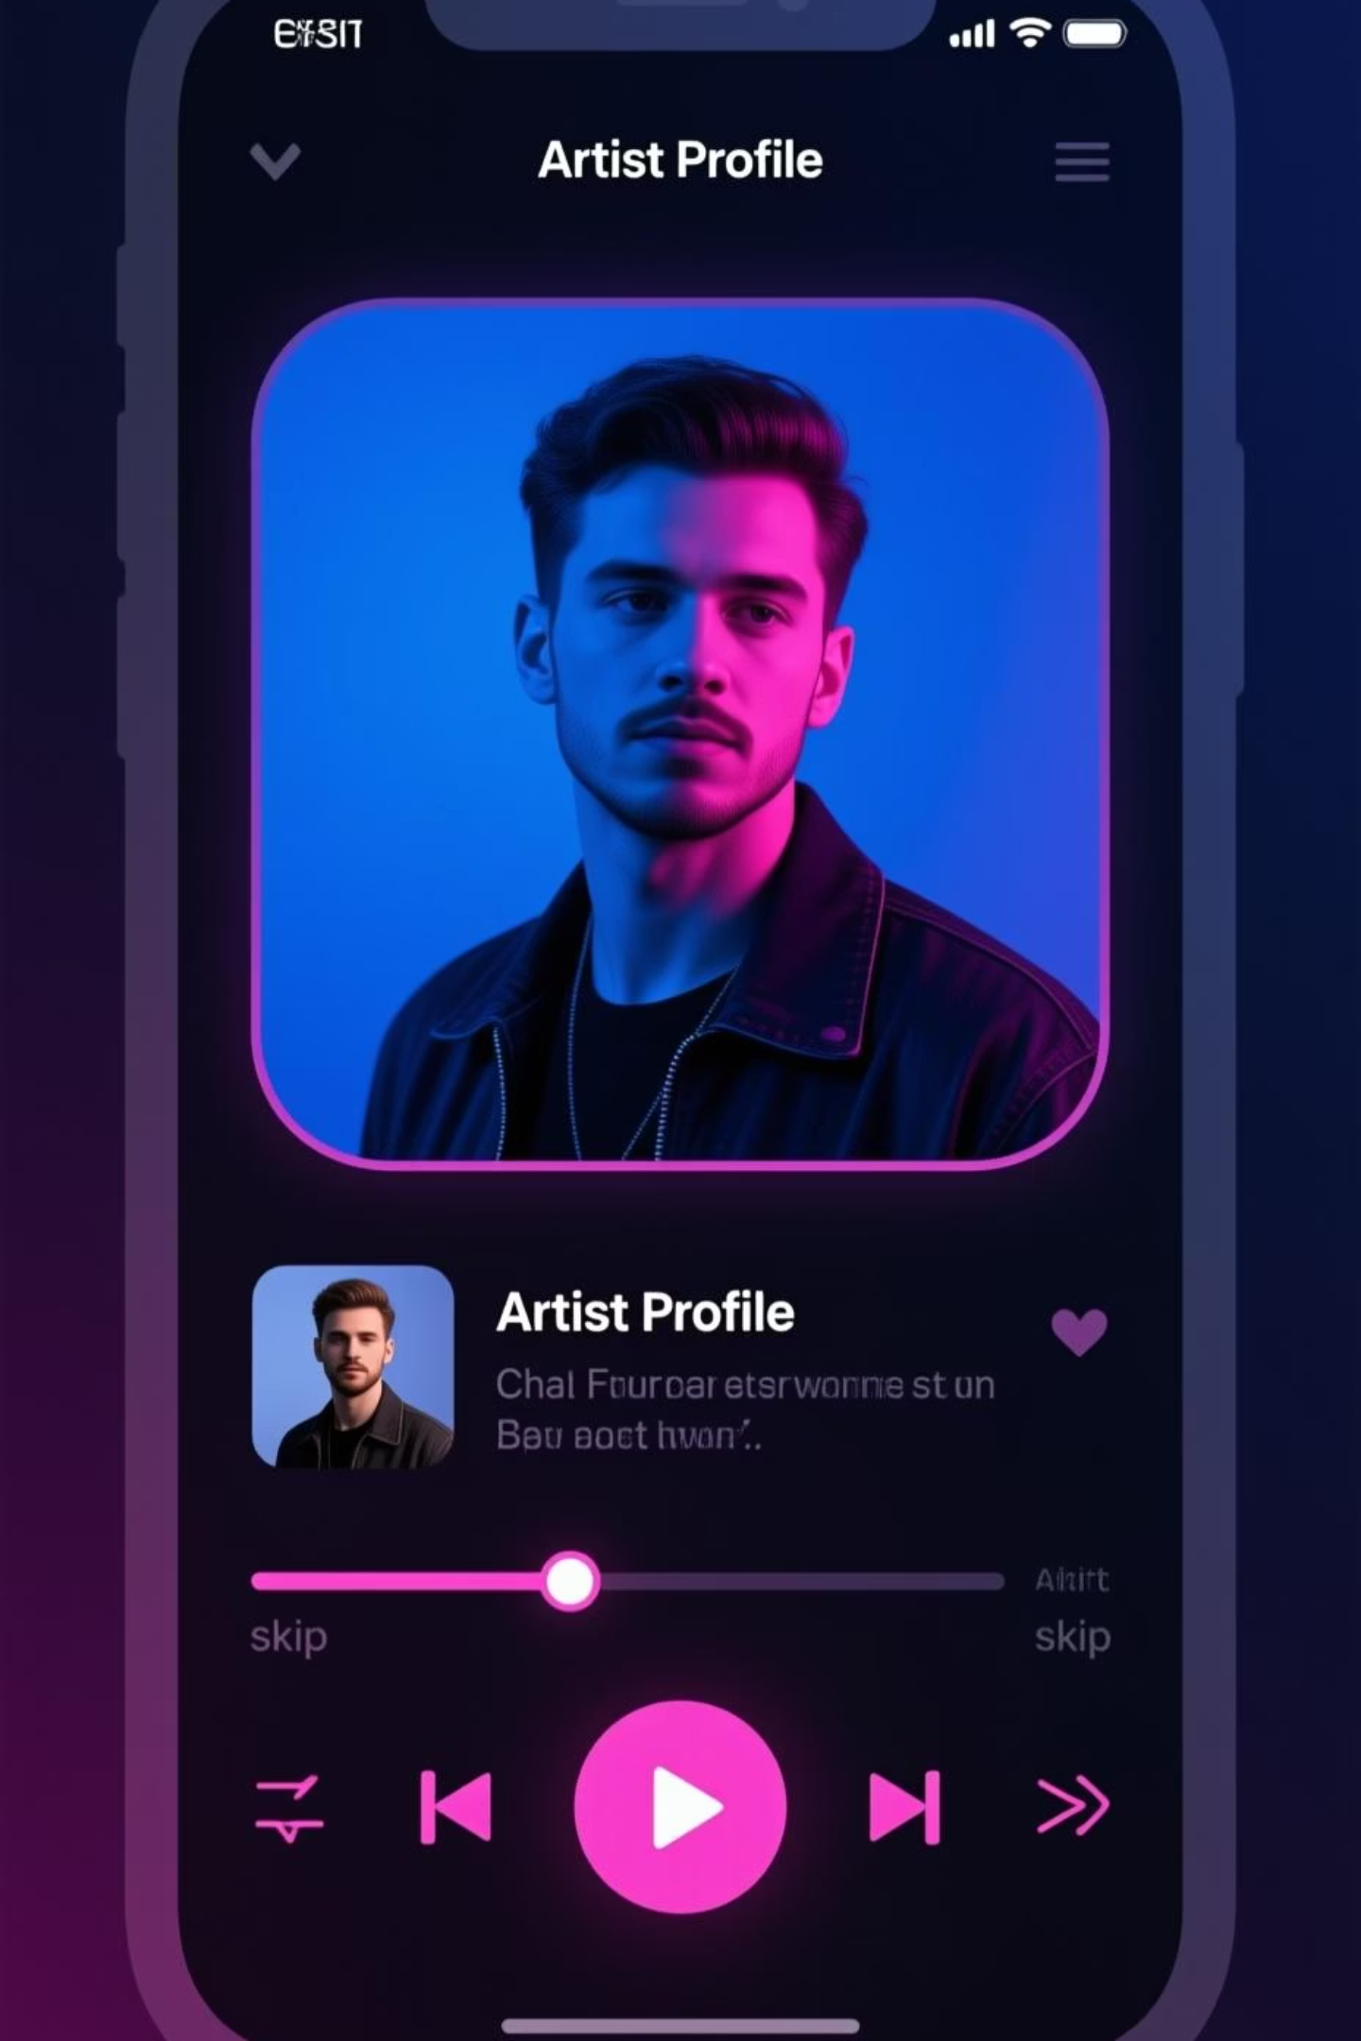
User Experience Design
For Listeners
For Creators
Personalized discovery through trusted curators
Analytics dashboard with real fan insights
Direct connection with artists via messages and content
Direct messaging with engaged listeners
Seamless playlist sharing with curated recommendations
Release tools for singles and exclusive drops
Offline listening and high-fidelity audio options
Revenue tracking with monthly payouts

Slide 6
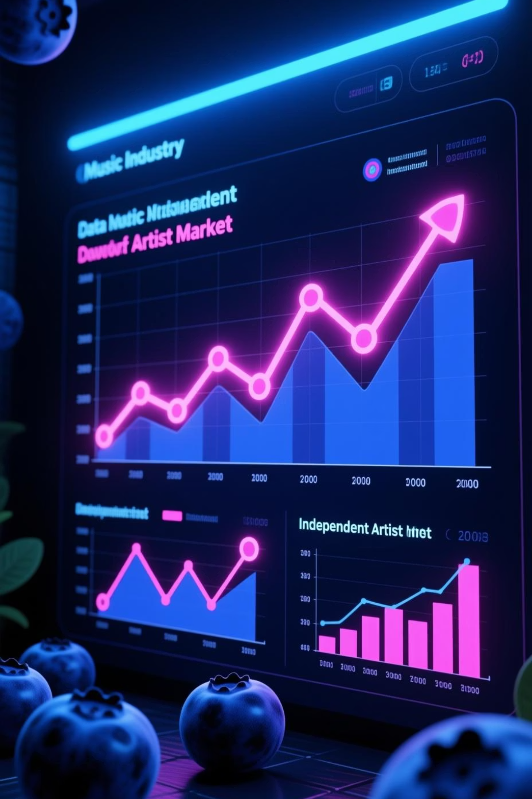
The Market Opportunity
The global music streaming market reached $15.2B in 2023 and continues growing at 10% annually. Independent artists now represent 25% of streams on major platforms, yet receive only 12% of revenue—a massive opportunity for a platform that serves them better.
25%
65M
$15.2B
Independent Artist Streams
Independent Artists Globally
Streaming Market Size
Growing share of total music consumption
Underserved by existing platforms
Fast-growing industry segment

Slide 7

Monetization Strategy
Platform ecosystem
Premium subscriptions
Centralized growth & reinvestment
$9.99/month consumer tier
EchoTune Revenue Streams
Creator partnerships
Brand partnerships
Sponsored playlists & campaigns
Artist commissions & fan support

Slide 8
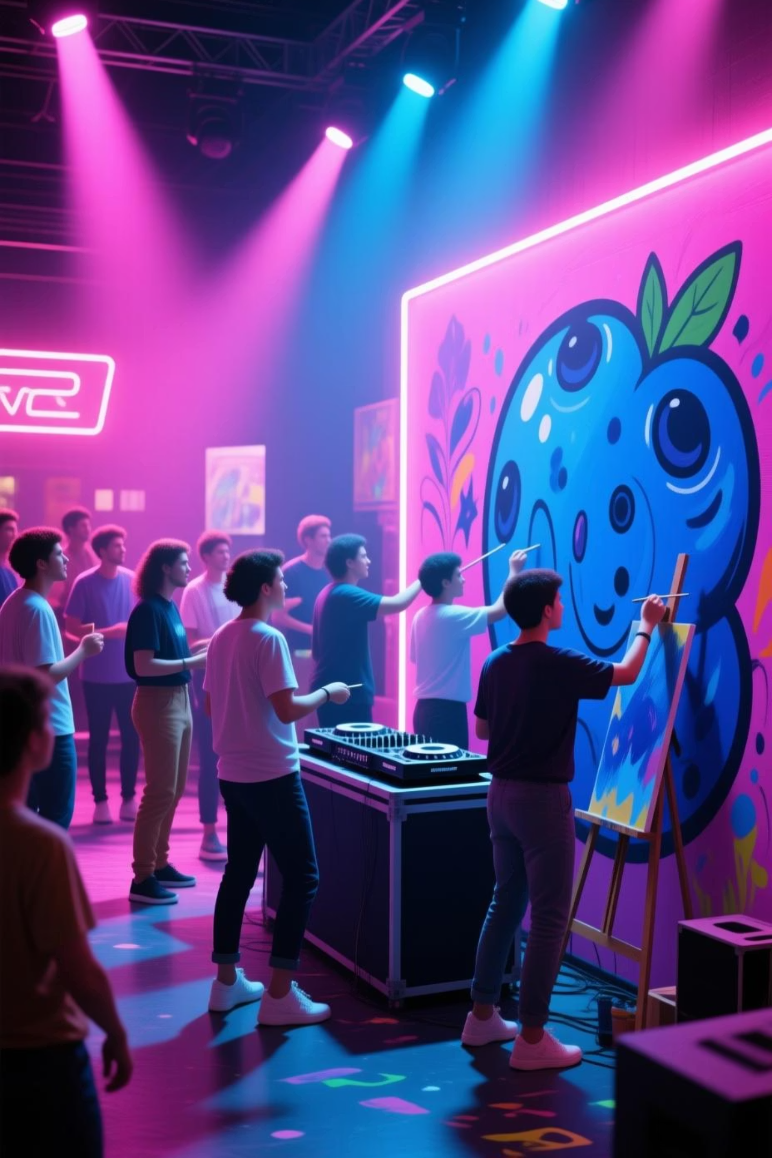


Go-to-Market Strategy
01
02
Phase 1: Creator Onboarding
Phase 2: Community Building
Launch with 10,000 independent artists through partnerships with music communities and creator networks
Grow listener base through referral programs and influencer partnerships, targeting music enthusiasts and playlist curators
03
Phase 3: Scale & Partnerships
Expand artist roster, introduce premium features, and secure brand partnerships for sustainable growth

Slide 9





Why EchoTune Wins
Creator-First
Built for artists, not labels
Community
Human connection matters
Transparent
Clear economics and metrics
Authentic
Real curation, real stories

Slide 10

Join the Movement
EchoTune is more than a streaming platform—it's a revolution in how music connects creators with listeners. We're building a sustainable ecosystem where talent thrives, discovery feels real, and every play counts.
For Investors
For Artists
Tap into a $15B+ market with a differentiated model and underserved user segments
Get discovered, build fans, and earn fairly from day one
For Listeners
Experience music discovery that feels personal and authentic

